Slide 1
ENROLLMENT SYSTEM FOR SENIOR HIGH SCHOOL IN CAVITE NATIONAL HIGH SCHOOL, CAVITE

Slide 2
introduction
In order to acquire formal education, the child should be enrolled in an educational institution duly recognized by the Department of Education. Both public and private schools have a different process of enrollment. In public high school, many are still using the manual procedure of enrollment. Enrollment system (ES) is one of the most important, not only in a university, but also in lower levels of education. ES is used particularly to record and retrieve student’s information.
Currently, Senior High School – Cavite National High School is all the work at the time of admission of the students is done manually by ink and paper, which is very slow and consuming much efforts and time. Due to increase in enrollment every year, the manual process is no longer effective in registering students. It is required to design of a computerized automated student enrollment system, to speed up an accurate and efficient data records. The purpose of this Enrollment System for Senior High School, Cavite National High School is to support the new, old and transferee students’ admission and registration process, and to track personal information and academic data.

Slide 3
Statement of the problem
The general problem of Senior High School of Cavite National High School is how to improve the process of enrollment.
Specifically, the study seeks to answer the following question:
How to secure reliable student’s records and files?
How to avoid the redundancy of the records?
How to generate reports in a timely matter?

Slide 4
Objectives of the study
This study aimed to develop an enrollment system for Senior High School in Cavite National High School.
Specifically, it aims to:
develop a system with the following features:
Add and Edit Student Records;
Assessing the student’s taken course;
Print reports and records;
Backup files;
create the system using Microsoft Visual Studio 2013 for Integrated Development Environment, Visual Basic.NET for program and MySQL for backend;
test and improve the system; and
evaluate the system based on ISO 25010.

Slide 5
Significance of the study
The study will be beneficial to client for their process of enrollment of Senior High School of Cavite National High School. The increase in population of the students signifies that need for faster and more effective enrollment process. The proposed system helps to register student’s, update record’s and to track information in more convenient ways.
Further, it will also be beneficial to the researcher for it will enhanced their programming capacity.
Lastly, the study will be beneficial to the future researcher in conduct of a similar and related study.

Slide 6
Time and place of the study
This study was being conducted at Cavite National High School at Cavite City, Cavite May 2020 to May 2020.

Slide 7
Scope and limitation of the study
The study helped the students as well as the client in providing faster, easier, and more accurate information on subjects that would be enrolled by the student for a particular semester and year level.
The system is comprised of log-in module, admission module, enrollment module reports module and maintenance module. The First module has its sub module that is capable of adding new student’s, edit and view personal information and track/strand that the student take. The second has its sub module where in capable to input and edit and view grades of the students. Third module has its sub module that is capable to generate reports like printing grades, master list, check list and registration form. And lastly, the fourth module has its sub module where in capable of add and edit accounts, adding school year, adding subjects and subject code, view activity log and to back up all the records stored in database.
The proposed system is design to run on Windows 7 up to Windows 10 operating system and supports runtime on a network environment.

Slide 8
Operational definition of terms
This part of the study operatively defines terms that were used in the study.
Automated refers to automatic processing of documents.
Back Up refers to recovering and restoring data in relation to database.
Computerized refers to automatic method of processing using a computer or machine.
Check List refers to the all subject of a course or strand.
Database refers to a collection of an integrated collection of logically related records.
Develop refers to the creation of new system that replaces the old method.
Enrollment refers to act of enrolling at an institution or a course.
Enrollment System refers a system that record and retrieve a student’s information.
Evaluation refers to the process of knowing the student’s competencies.
Manual refers a step by step procedure using manual process.
Security refers protection or security of the data.

Slide 9
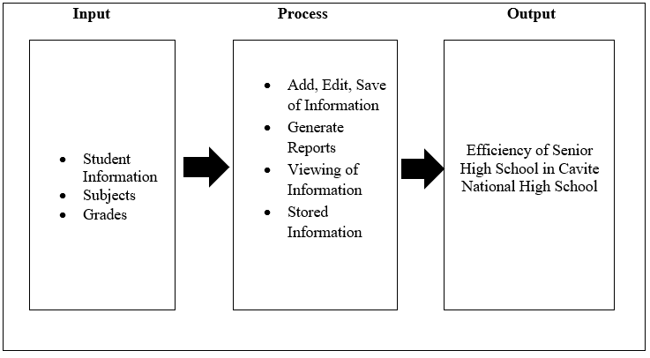
Conceptual framework
The conceptual framework of the study is illustrated in Figure 1. It showed the input, process and the output of how the study will be done

Slide 10
Figure 1. Conceptual Framework of Senior High School in Cavite National High School
Figure 1 shows the different attributes in the accomplishment of the objectives of the study. The input phase consisted of inputting information of the student in the system. The process phase is what the system capability to do and in this process phase includes the software requirements includes the software used to create the study: Microsoft Visual Studio 2013 (above) for frontend and MySQL for backend. The study developing its concept and programs and testing as part of the process phase. The Enrollment System of Senior High School in Cavite City was the output phase of the study and will evaluate using the ISO 25010.

Slide 11
Review of related literature
Background of Cavite National High School
Manual Process
Computerized Process
Visual Studio 2013
Security
Education System in Philippines
K-12 Education
Enrollment System
MySQL
Advantages of MySQL

Slide 12
Review of related literature
Disadvantages of MySQL
ISO 25010
System Administrator
Programming Language
Learning Reference Number (LRN)
Importance of Enrollment System
Designing of Enrollment System
K-12 Program
Advantages of Enrollment System
Disadvantage of Enrollment System

Slide 13
methodology
This chapter presents the steps of how the system will be developed. It discusses the procedures for generating information on the system, enumerates how the system will be tested, and indicate its criteria for evaluation. It also describes the research methodology of the study, explains the sample processes with the aid of the Data Flow Diagram, and to describe the procedure used in designing the system.
Project Design
The developers considered several concepts for the development of the system. Everything was consolidated and presented using a context diagram shown below.

Slide 14
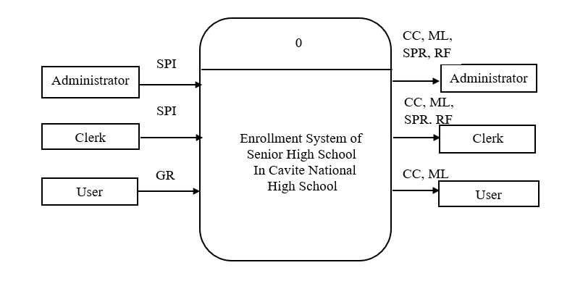
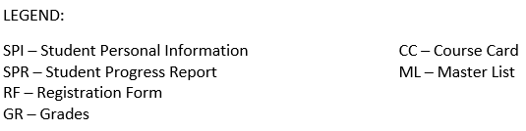
Project design

Slide 15
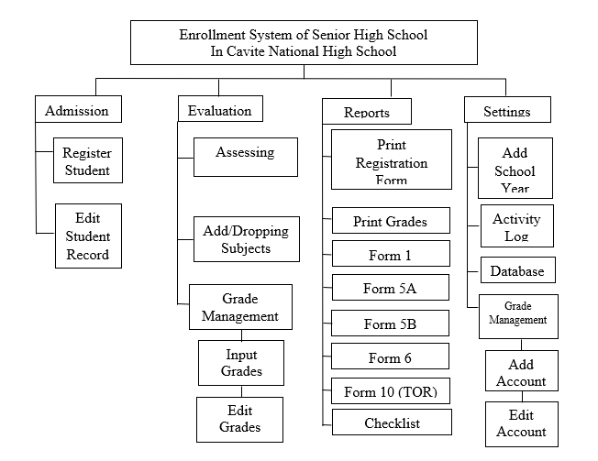
Functional decomposition diagram
Functional Decomposition Diagram
The module of decomposition identifies each of the modules and briefly outlines their purpose, type, functions, and list of submodules consisting of this module.

